Slide 1
UML Unified Modelling Language
Dr. Santosh Kumar Swain
Professor
School Of Computer Engineering
KIIT , Bhubaneswar.

Slide 2
Model
A model is an abstract representation of a system (process or structure) prior to building or modifying it.
A model is simplification of reality.
Modeling techniques used for analysis and design involve graphic languages (sets of symbols).
Modeling is used frequently during many phases of software development frequently.

Slide 3
Modeling Language
A modeling language must include
Model elements– fundamental modelling concepts and semantics.
Notation – Visual rendering of model elements.
Guidelines – expression of usage within the trade.
Benefits of visual notation are
Clarity
Familiarity
Maintenance
Simplification

Slide 4
Advantages of Modeling
Turban cites
Easier to express complex ideas.
Reduction of complexity.
Enhance and reinforce learning and training.
Manipulation is easier
Key ideas regarding modeling are
Rarely correct in first try.
Always seek advice and criticism for others.
Avoid excess model revisions.

Slide 5
Model Representation
Static Model – viewed as a snapshot of a system’s parameter at rest at a specific point in time.
Represent the structural or static aspect of a system.
Dynamic Model – viewed as a collection of procedures or behaviors
Reflect the behavior of a system over time.
Show how the business objects interact to perform tasks.

Slide 6
What is UML?
UML – Unified Modeling Language is a
Standard graphical or modeling language for specifying, visualizing, constructing and documenting the artifacts of software intensive systems.
Collection of best engineering practices that have proven successful in modeling large and complex systems.

Slide 7
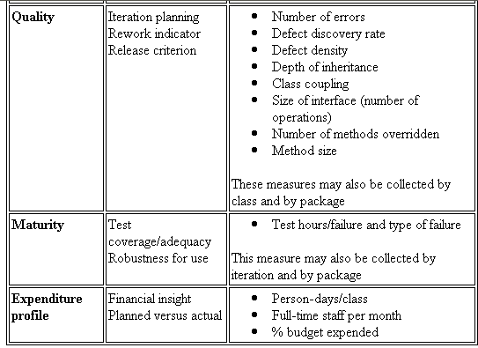
UML Diagram – What is UML?
The Unified Modeling Language (UML) is a standard language for
Specifying
Visualizing
Constructing
Documenting
the artifacts of software intensive system.

Slide 8
Goals of UML
Provide users with a ready-to-use, expressive visual modeling language so they can develop and exchange meaningful models.
Provide extensibility and specialization mechanisms to extend the core concepts.
Be independent of particular programming languages and development processes.
Provide a formal basis for understanding the modeling language.
Encourage the growth of the OO tools market.
Support higher-level development concepts such as collaborations, frameworks, patterns and components.
Integrate best practices.

Slide 9
Why use UML?
Helps to reduce cost and time-to-market.
Helps managing a complex project architecture.
Helps to convey ideas between developers \ designers \ etc.

Slide 10
Background
1996 – Release of UML 0.9 by by Grady Booch, Jim Rumbaugh of Rational Software Corporation, Ivar Jacobson of Objectory company.
1996 – Release of UML 1.0 by Digital Equipment, HP, Ilogix, IntelliCorp, IBM, ICON, MCI, Microsoft, Oracle, Rational, TI and Unisys.
1997 – Release of UML 1.1 by IBM, ObjecTime, Platinum, Ptech, Taskon, Reich and Softeam
2001 – Work on UML 2.0 specifications.

Slide 11
UML Lineology
Based Principally on:
OMT [Rumbaugh 1991]
Booch’s methodology[Booch 1991]
OOSE [Jacobson 1992]
Odell’s methodology[Odell 1992]
Shlaer and Mellor [Shlaer 1992]

Slide 12
Different Object Modeling Techniques in UML
OMT
UML
Booch’s
Methodology
OOSE

Slide 13
UML as A Standard
Adopted by Object Management Group (OMG) in 1997.
OMG is an association of industries
Promotes consensus notations and techniques
Used outside software development
Example car manufacturing

Slide 14
Developments to UML
UML 2.0
UML continues to develop:
Refinements
Making it applicable to new contexts
Application to embedded systems
UML 1.X
UML 1.0

Slide 15
Object Modelling Using UML
UML is a modelling language.
Not a system design or development methodology
Used to document object-oriented analysis and design results.
Independent of any specific design methodology.

Slide 16
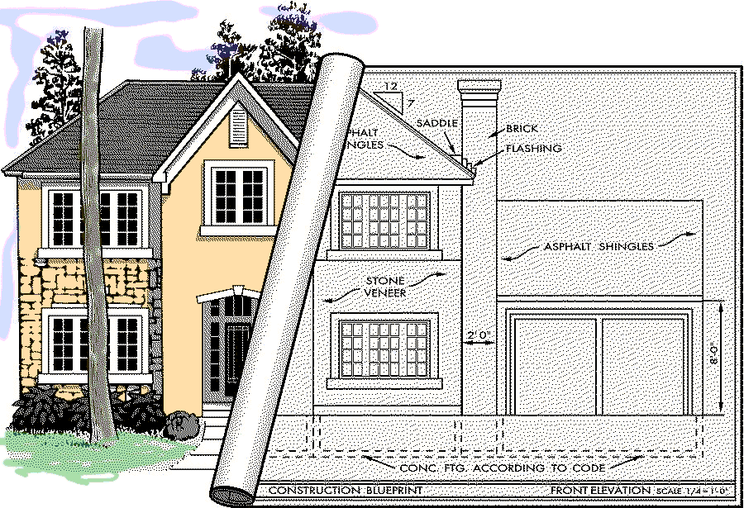
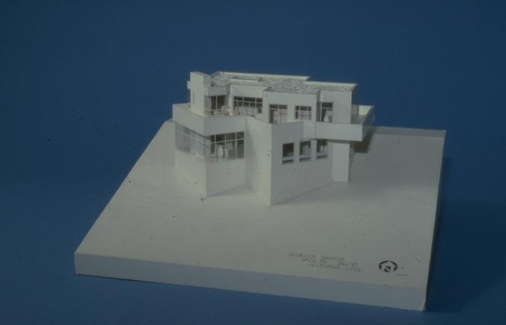
Modeling a House

Slide 17
UML Model Views
Views of a system:
User’s view
Structural view
Behavioural view
Implementation view
Environmental view

Slide 18
UML Diagrams
Behavioural View
Sequence Diagram
Collaboration Diagram
- State-chart Diagram
- Activity Diagram
Structural View
Class Diagram
Object Diagram
User’s View
Use Case
Diagram
Implementation View
Component Diagram
Environmental View
Deployment Diagram
Diagrams and views in UML

Slide 19
Basic Building Blocks of The UML
There are four kinds of things in the UML.
1. Structural Things.
2. Behavioral Things.
3. Grouping Things.
4. Annotational Things.

Slide 20
Things in UML
Structural Things
Behavioral Things
Grouping Things
Annotational Things
1. Class
1. Interaction
1. Packages
1. Notes
2. Interface
2. State Mechanism
3. Collaboration
4. Use Case
5. Active Class
6. Components
7. Nodes

Slide 21
Diagrams in UML
A Diagram is the graphical presentation of a set of elements, most often rendered as a connected graph of things and relationships. Every complex system is best approached through a mall et of nearly independent views of a model; no single view is sufficient. Every model may be expressed at different levels of fidelity. UML includes 9 such diagrams.
Static(structural)
1 Class Diagram.
2 Object Diagram.
3 Implementation Diagram
3.1 Component Diagram
3.2 Deployment Diagram
Dynamic(Behavioral)
4 Use Case Diagram
5 Interaction Diagram
5.1 Sequence Diagram
5.2 Collaboration Diagram.
6 State Chart Diagram.
7 Activity Diagram.

Slide 22
Relationships
UML have 4 kinds of relationships:
Association – Two classes are associated if one class has to know about the other.
Aggregation – An association in which one class belongs to a collection in the other.
Composition
Generalization – An inheritance link indicating one class is a base class of the other.
Dependency – A labeled dependency between classes (such as friend classes, instantiation)
Realization --

Slide 23
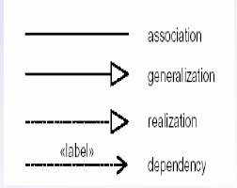

Slide 24
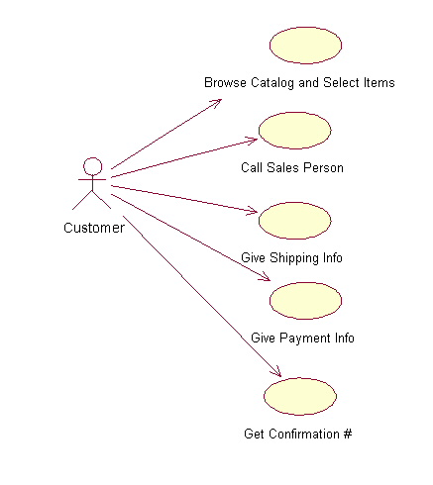
Use case diagram
System boundary:
indicates the scope of your system. Anything within the box represents functionality that is in scope and anything outside the box is not
System boundary
overview the usage requirements
presentations project stakeholders
"the meat" of the actual requirements
Actor
Actor:
An actor is a person, organization, or external system that plays a role in one or more interactions with your system
Use case
Use case:
A use case describes a sequence of actions that provide something of measurable value to an actor and is drawn as a horizontal ellipse
Online C2C shopping

Slide 25
Use Case Diagrams
Describes what a system does from the standpoint of an external observer.
Emphasis on what a system does rather then how.
Scenario – an example of what happens when someone interacts with the system.
Actor – A user or another system that interacts with the modeled system.
A use case diagram describes the relationships between actors and scenarios.
Provides system requirements from the user’s point of view.

Slide 26
Use Case Diagrams
UML defines 3 kinds of associations:
Association – defines a relationship between an actor and a use case.
Extend - defines that instances of a use case may be augmented with some additional behavior defined in an extending use case.
Uses - defines that a use case uses a behavior defined in another use case.

Slide 27
Use Case Relation
<<include>> used when one use case will invoke another use case.
<<extends>> used when one use case may invoke another use case.

Slide 28
Representation of Use Cases
Represented by use case diagram
A use case is represented by an ellipse
System boundary is represented by a rectangle
Users are represented by stick person icons (actor)‏
Communication relationship between actor and use case by a line
External system by a stereotype

Slide 29
Use Case Diagram Example1
Tic-tac-toe game
Play Move
Player
Use case model

Slide 30
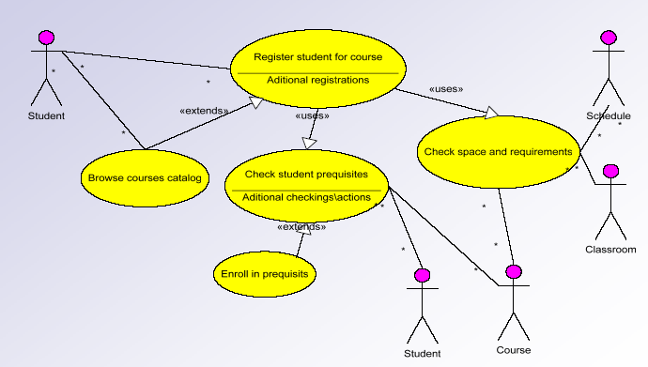
Use Case Example2

Slide 31
Use Case Model
Consists of set of “use cases”
An important analysis and design artifact
The central model:
Other models must confirm to this model
Not really an object-oriented model
Represents a functional or process model

Slide 32
Use Cases
Different ways in which a system can be used by the users
Corresponds to the high-level requirements
Represents transaction between the user and the system
Defines external behaviour without revealing internal structure of system
Set of related scenarios tied together by a common goal.

Slide 33
Use Cases Cont…
Normally, use cases are independent of each other
Implicit dependencies may exist
Example: In Library Automation System, renew-book and reserve-book are independent use cases.
But in actual implementation of renew-book--- A check is made to see if any book has been reserved using reserve-book.

Slide 34
Example Use Cases
Library information system
issue-book
query-book
return-book
create-member
add-book, etc.

Slide 35
Factoring Use Cases
Two main reasons for factoring:
Complex use cases need to be factored into simpler use cases
To represent common behavior across different use cases
Three ways of factoring:
Association/Generalization
Includes
Extends

Slide 36
Factoring Use Cases Using Generalization
Pay membership fee
Pay through credit card
Pay through library pay card

Slide 37
Factoring Use Cases Using Includes
Base use case
Common
use case
<<include>>
Base use case 2
Base use case 1
<<include>>
<<include>>
<<include>>
<<include>>
Common use case
Common use case
Common use case

Slide 38
Example of Factoring Use Cases Using Includes
Issue Book
Renew Book
<<include>>
<<include>>
Check Reservation

Slide 39
Factoring Use Cases Using Extends
Base
use case
Common
use case
<<extends>>

Slide 40
Factoring Use Cases Using Extends
Order
Item
Show
Catalog
<<extends>>

Slide 41
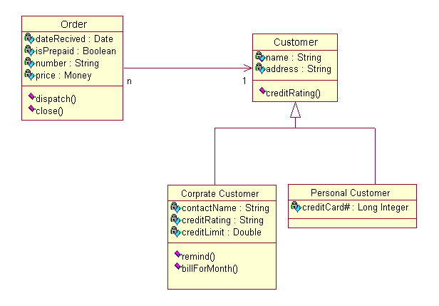
Class Diagram
Name
Class diagrams show the classes of the system, their interrelationships (including inheritance, aggregation, and association), and the operations and attributes of the classes.
Associations
Aggregation
Generalization
Relations
Attributes
Operations

Slide 42
Class Diagram
Displays objects structure, contents and relationships.
Class diagrams are static – display what interacts but not what happens when interaction occurs.

Slide 43
Class Diagram
Classes are represented by a rectangle divided to three parts: class name, attributes and operations.
Attributes are written as:
visibility name [multiplicity] : type-expression = initial-value
Operations are written as:
visibility name (parameter-list) : return type-expression
Visibility is written as:
+ public
# protected
- private

Slide 44
Class Diagrams
Class Diagrams describe the static structure of a system, or how it is structured rather than how it behaves. These diagrams contain the following elements.
Classes, which represent entities with common characteristics or features. These features include attributes, operations and associations.
Associations, which represent relationships that relate two or more other classes where the relationships have common characteristics or features. These attributes and operations.

Slide 45
Class Diagram
Describes static structure of a system
Main constituents are classes and their relationships:
Generalization
Aggregation
Association
dependencies
Connected as a graph to each other and to their contents

Slide 46
Class Diagram
Entities with common features, i.e. attributes and operations.
Classes are represented as solid outline rectangle with compartments.
Compartments for name, attributes, and operations.
Attribute and operation compartments are optional depending on the purpose of a diagram.

Slide 47
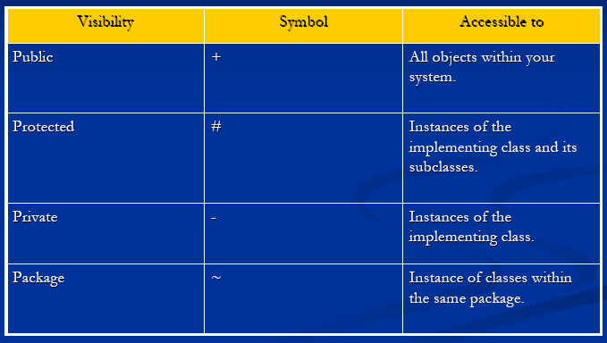
Visibility

Slide 48
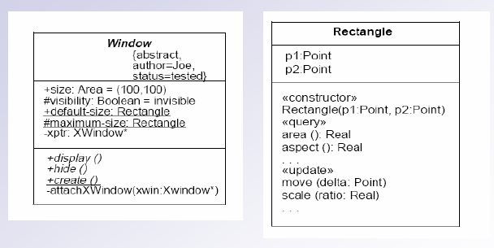
Class Diagram

Slide 49
Object Diagram
Shows snapshot of detailed state of the system at a point of time.
Notation is same a class diagram.
Class diagrams can contain objects
So a class diagram with objects and no classes is an object diagram.

Slide 50
Object Diagrams
Object Diagrams describe the static structure of a system at a particular time. Whereas a class model describes all possible situations, an object model describes a particular situation. Object diagrams contain the following elements:
Objects, which represent particular entities. These are instances of classes.
Links, which represent particular relationships between objects. These are instances of associations.
.

Slide 51
Object Diagram
LibraryMember
Mritunjay
B10028
C-108, Laksmikant Hall
1119
Mrituj@cse
25-02-04
25-03-06
NIL
IssueBook( );
findPendingBooks( );
findOverdueBooks( );
returnBook( );
findMembershipDetails( );
LibraryMember
Mritunjay
B10028
C-108, Laksmikant Hall
1119
Mrituj@cse
25-02-04
25-03-06
NIL
LibraryMember
Different representations of the LibraryMember object

Slide 52
Interaction Diagram
Models how groups of objects collaborate to realize some behaviour
Typically each interaction diagram realizes behaviour of a single use case

Slide 53
Interaction Diagram
Two kinds:
Sequence and Collaboration diagrams.
Two diagrams are equivalent
Portray different perspectives
These diagrams play a very important role in the design process.

Slide 54
Sequence Diagram
Shows interaction among objects as a two-dimensional chart
Objects are shown as boxes at top
If object created during execution then shown at appropriate place
Objects existence are shown as dashed lines (lifeline)‏
Objects activeness, shown as a rectangle on lifeline

Slide 55
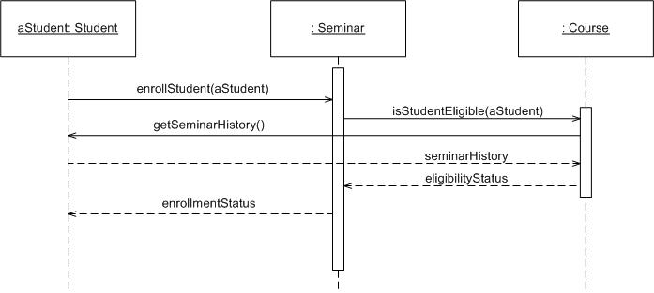
Sequence Diagram
Object: Class
A sequence diagram is
An interaction diagram that details how operations are carried out.
What messages are sent and when.
Sequence diagrams are organized according to time
Message
Operations
Lifeline

Slide 56
Sequence Diagram Cont…
Messages are shown as arrows.
Each message labelled with corresponding message name.
Each message can be labelled with some control information.
Two types of control information:
condition ([])‏
iteration (*)‏

Slide 57
Elements of a Sequence Diagram
object
control
lifetime
message

Slide 58
Example Cont…
Sequence of message sending

Slide 59
An Example of A Sequence Diagram
:Library
Boundary
:Library
Book
Renewal
Controller
:Library
Book
Register
:Book
:Library
Member
renewBook
find MemberBorrowing
displayBorrowing
selectBooks
bookSelected
* find
[reserved]
[reserved]
apology
update
apology
confirm
confirm
updateMemberBorrowing
Sequence Diagram for the renew book use case

Slide 60
Collaboration Diagram
Shows both structural and behavioural aspects
Objects are collaborator, shown as boxes
Messages between objects shown as a solid line
A message is shown as a labelled arrow placed near the link
Messages are prefixed with sequence numbers to show relative sequencing

Slide 61
An Example of A Collaboration Diagram
:Library
Book
Register
6: * find
:Book
[reserved]
9: update
8: apology
5: book
Selected
10: confirm
:Library
Boundary
1: renewBook
:Library
Book
Renewal
Controller
[reserved]
7: apology
3: display
Borrowing
4: selectBooks
2: findMemberBorrowing
12: confirm
:Library
Member
updateMemberBorrowing
Collaboration Diagram for the renew book use case

Slide 62
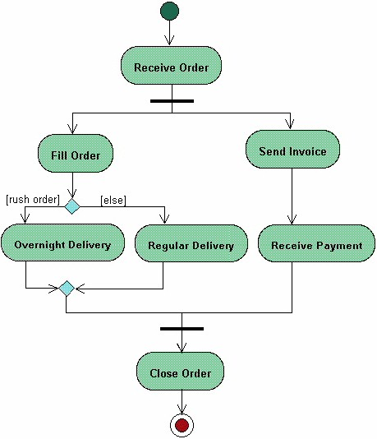
Activities Diagram
Start
Fork
Activity diagrams describe the workflow behaviour of a system
Branch
Merge
Joint
End

Slide 63
Activity Diagram
Not present in earlier modelling techniques:
Possibly based on event diagram of Odell [1992]
Represents processing activity, may not correspond to methods
Activity is a state with an internal action and one/many outgoing transitions
Somewhat related to flowcharts

Slide 64
Activity Diagram vs Flow Chart
Can represent parallel activity and synchronization aspects
Swim lanes can be used to group activities based on who is performing them
Example: academic department vs. hostel

Slide 65
Activity Diagram
Normally employed in business process modelling.
Carried out during requirements analysis and specification stage.
Can be used to develop interaction diagrams.

Slide 66
An Example of An Activity Diagram
Academic Section
Accounts Section
Hostel Office
Hospital
Department
check
student
records
receive
fees
allot
hostel
create
hospital
record
receive
fees
register
in
course
conduct
medical
examination
allot
room
issue
identity card
Activity diagram for student admission procedure at IIT

Slide 67
Activity Diagram: Example 2
Finance
Order
Processing
Stock
Manager
Receive
Order
Receive
Supply
*[for each line
item on order]
Choose
Outstanding
Order Items
Authorize
Payment
Check
Line Item
[failed]
[in stock]
* [for each chosen
order item]
Cancel
Order
Assign to
Order
Assign
Goods to
Order
[succeeded]
[need to reorder]
Reorder
Item
[stock assigned to all
line items and payment
authorized]
[all outstanding
order items filled]
Dispatch
Order

Slide 68
State Chart Diagram
Based on the work of David Harel [1990]
Model how the state of an object changes in its lifetime
Based on finite state machine (FSM) formalism

Slide 69
State Chart Diagram Cont…
State chart avoids the problem of state explosion of FSM.
Hierarchical model of a system:
Represents composite nested states.

Slide 70
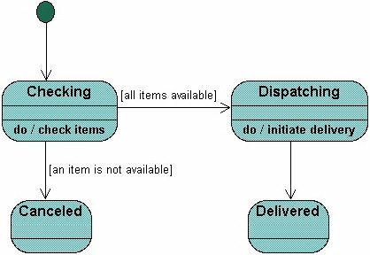
State Machine Diagram
A State Machine diagram
shows the possible states of
the object and the transitions
that cause a change in state.
?
What is different between activities and Statemachine diagram

Slide 71
State Chart Diagram Cont…
Elements of state chart diagram
Initial State: A filled circle
Final State: A filled circle inside a larger circle
State: Rectangle with rounded corners
Transitions: Arrow between states, also boolean logic condition (guard)‏

Slide 72
An Example of A State Chart Diagram
order received
Unprocessed
Order
[reject] checked
[accept] checked
Rejected
Order
Accepted
Order
[some items available]
processed / deliver
[some items not
available] processed
Pending
Order
[all items
available]
newsupply
Fulfilled
Order
Example: State chart diagram for an order object

Slide 73
Package Diagrams
A package is a grouping of several classes:
Java packages are a good example
Package diagrams show module dependencies.
Useful for large projects with multiple binary files
Order Capture
UI
AWT
Mailing List
UI
Order Capture
Application
Mailing List
Application
Dependency
Common
{global}
Oracle
Interface
Quantity
Money
DateRange
Domain
Orders
Customers
Sybase
Interface
Database
Interface
{abstract}

Slide 74
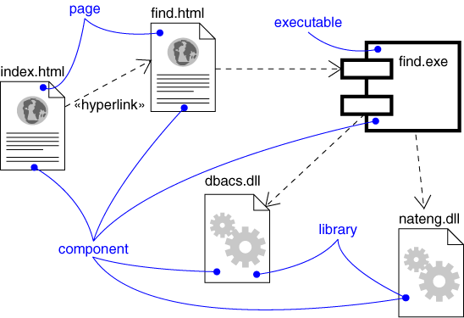
Component Diagram
Captures the physical structure of the implementation (code components)‏
dependency
Components:
Executables
Library
Table
File
Document

Slide 75
Component Diagram
Captures the physical structure of the implementation
Built as part of architectural specification
Purpose
Organize source code
Construct an executable release
Specify a physical database
Developed by architects and programmers

Slide 76
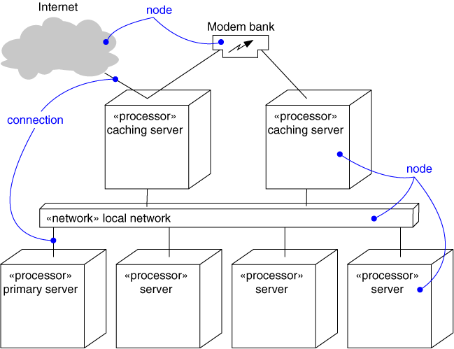
Deployment Diagram
Captures the topology of a system’s hardware
A piece of hardware

Slide 77
Are All Views Required for Developing A Typical System?
NO
For a simple system:
Use case diagram, class diagram and one of the interaction diagrams only.
State chart diagram:
when class has significant states.
When states are only one or two, state chart model becomes trivial
Deployment diagram:
In case several hardware components used to develop the system.

